Slide 1
ATAI
Advanced Techniqueof Artificial Intelligence
ATAI
ChongqingUniversity _{AdvancedTechniqueof}
of Technology Artificial Intelligence
Chongqing University of
Technology
Chongqing University ^{ATAI}
_{of Technology} Advanced Techniqueof
Artificial Intelligence
Chongqing University of Technology
Chongqing University of Technology
Collaboration and Transition: Distilling Item Transitions into
Multi-Query Self-Attention for Sequential Recommendation
https://github.com/zhuty16/MQSA-TED
—— WSDM 2024
Reported by ZhenDong Huanzg
1

Slide 2
ATAI
AdvancedTechniqueof
Artificial Intelligence
ATAI
ChongqingUniversity _{AdvancedTechniqueof}
of Technology Artificial Intelligence
ChongqingUniversity of Technology
Motivation
Definition 1.1 (Collaborative Signals). In the context of sequential recommendation, collaborative signals refer to the similarities between sequences of users’ interacted items.
Definition 1.2 (Transitional Signals). In the context of sequential recommendation, transitional signals refer to the transition frequency between pairs of users’ interacted items.
Although recent sequential recommendation methods such asSASRec have demonstrated remarkable performance, they stillencounter inherent limitations in effectively capturing both signals within user interaction sequences.

Slide 3
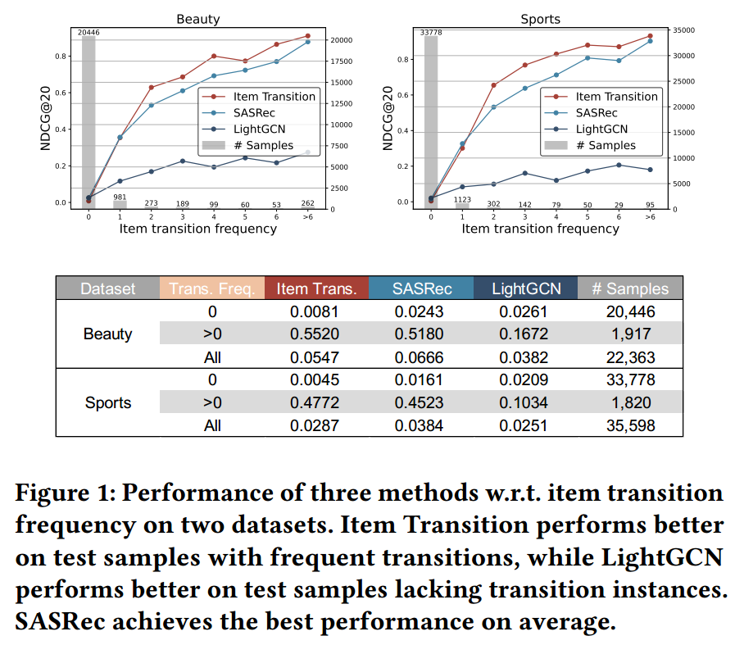
ATAI
AdvancedTechniqueof
Artificial Intelligence
ATAI
ChongqingUniversity _{AdvancedTechniqueof}
of Technology Artificial Intelligence
ChongqingUniversity of Technology
Motivation

Slide 4
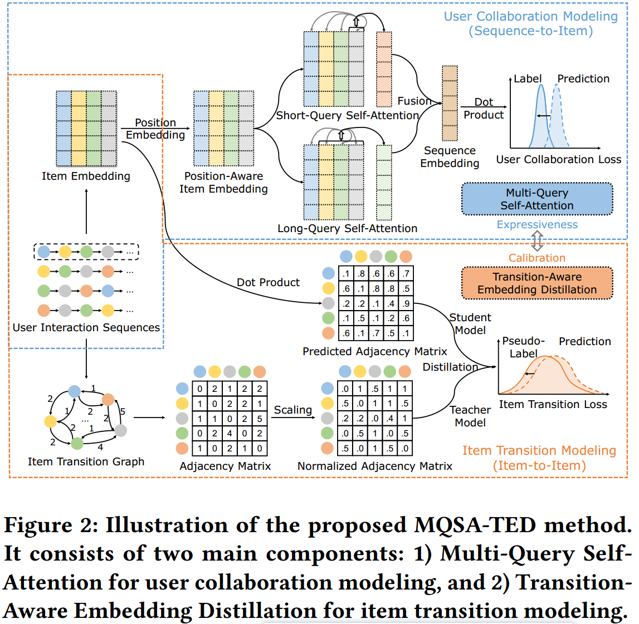
ChongqingUniversity of Technology
ATAI
AdvancedTechniqueof
Artificial Intelligence
ATAI
ChongqingUniversity _{AdvancedTechniqueof}
of Technology Artificial Intelligence
Overview

Slide 5
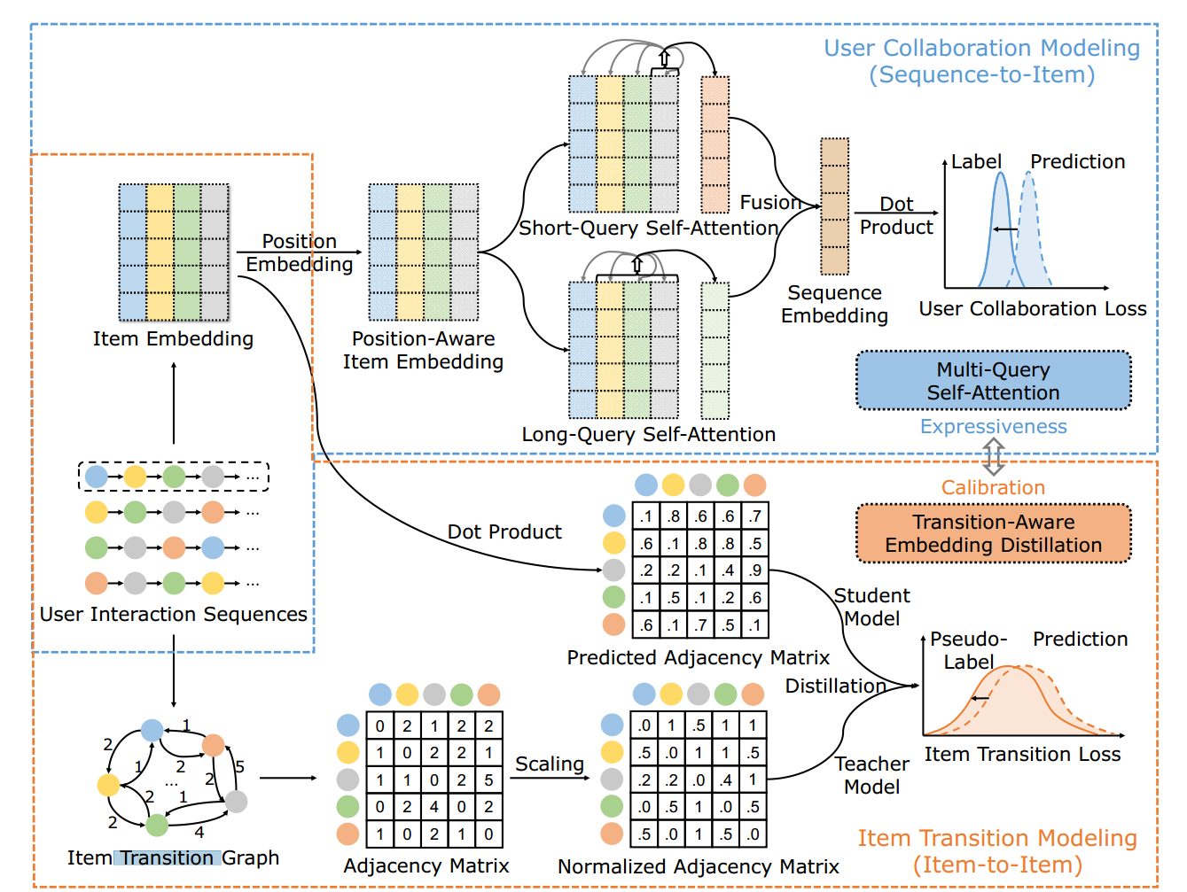
ChongqingUniversity of Technology
ATAI
AdvancedTechniqueof
Artificial Intelligence
ATAI
ChongqingUniversity _{AdvancedTechniqueof}
of Technology Artificial Intelligence
Method

Slide 6
ChongqingUniversity of Technology
ATAI
AdvancedTechniqueof
Artificial Intelligence
ATAI
ChongqingUniversity _{AdvancedTechniqueof}
of Technology Artificial Intelligence
Method

Slide 7
ChongqingUniversity of Technology
ATAI
AdvancedTechniqueof
Artificial Intelligence
ATAI
ChongqingUniversity _{AdvancedTechniqueof}
of Technology Artificial Intelligence
Method

Slide 8
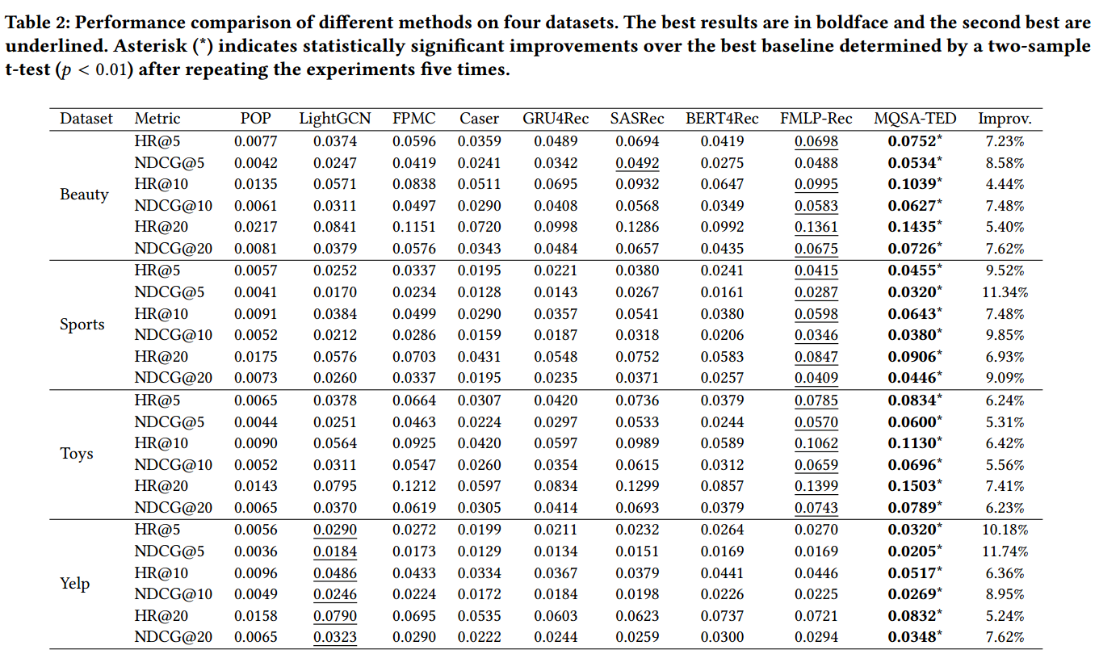
ATAI
AdvancedTechniqueof
Artificial Intelligence
ATAI
ChongqingUniversity _{AdvancedTechniqueof}
of Technology Artificial Intelligence
ChongqingUniversity of Technology
Experiments

Slide 9
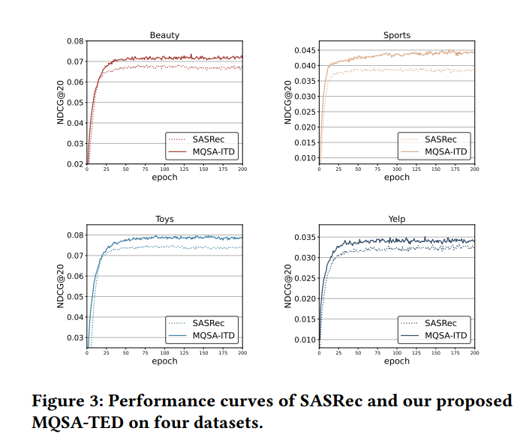
ATAI
AdvancedTechniqueof
Artificial Intelligence
ATAI
ChongqingUniversity _{AdvancedTechniqueof}
of Technology Artificial Intelligence
ChongqingUniversity of Technology
Experiments

Slide 10
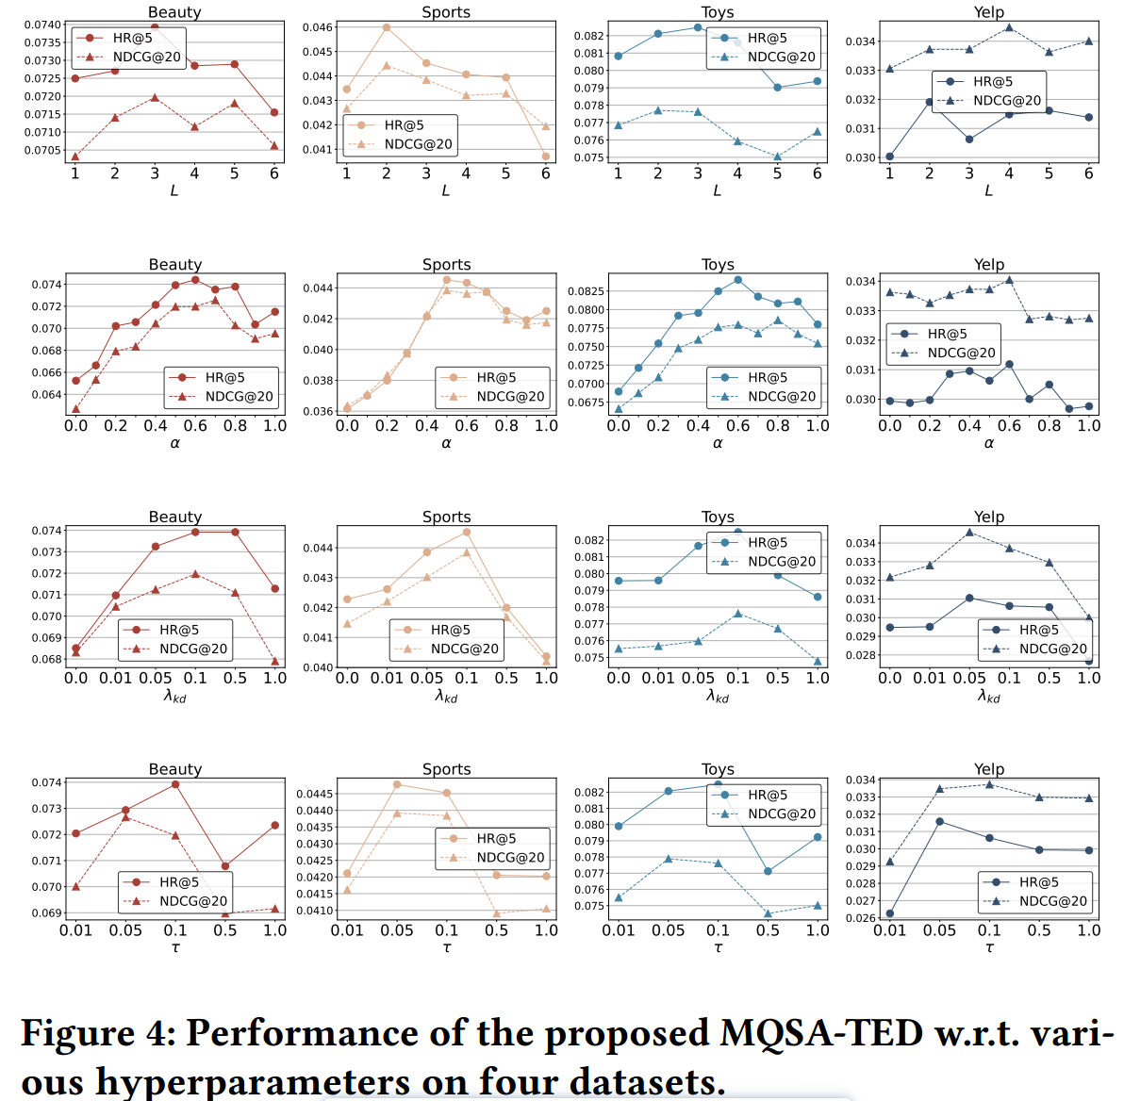
ChongqingUniversity of Technology
ATAI
AdvancedTechniqueof
Artificial Intelligence
ATAI
ChongqingUniversity _{AdvancedTechniqueof}
of Technology Artificial Intelligence
Experiments

Slide 11
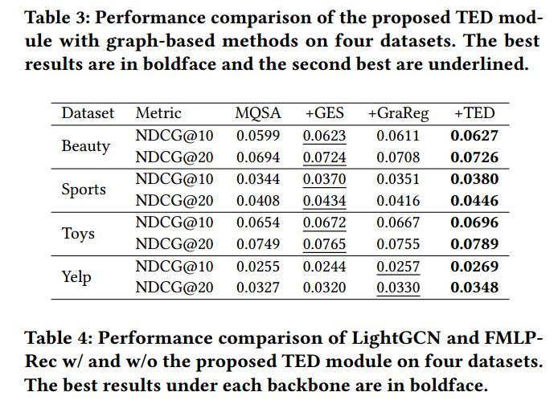
ChongqingUniversity of Technology
ATAI
AdvancedTechniqueof
Artificial Intelligence
ATAI
ChongqingUniversity _{AdvancedTechniqueof}
of Technology Artificial Intelligence
Experiments

Slide 12
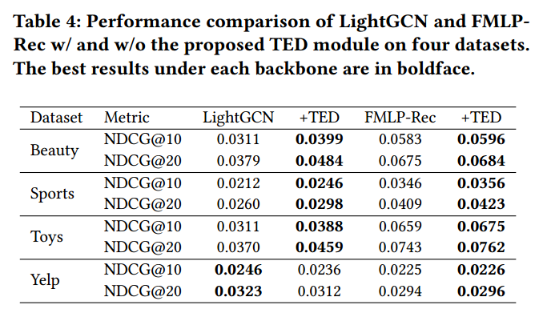
ChongqingUniversity of Technology
ATAI
AdvancedTechniqueof
Artificial Intelligence
ATAI
ChongqingUniversity _{AdvancedTechniqueof}
of Technology Artificial Intelligence
Experiments

Slide 13
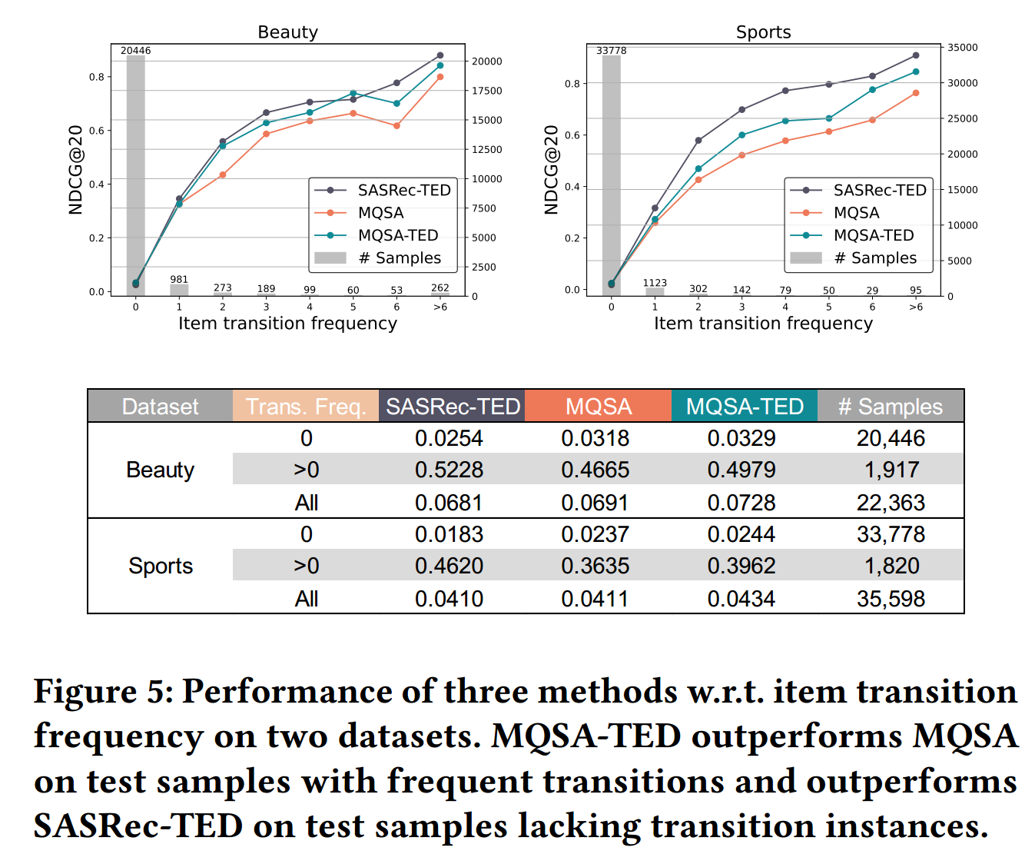
ChongqingUniversity of Technology
ATAI
AdvancedTechniqueof
Artificial Intelligence
ATAI
ChongqingUniversity _{AdvancedTechniqueof}
of Technology Artificial Intelligence
Experiments

Slide 14
ChongqingUniversity of Technology
ATAI
AdvancedTechniqueof
Artificial Intelligence
ATAI
ChongqingUniversity _{AdvancedTechniqueof}
of Technology Artificial Intelligence
Thanks!

